Slide 1

The Object Model

Slide 2
Object Oriented Design (OOD)
Object-Oriented Programming (OOP) is a paradigm based on objects
Objects contain data (attributes, properties) and code (methods, functions)
Objects are instances of classes, which determine their types
Object-Oriented Design (OOD) is the process of using objects and object- oriented programming when designing a software solution.

Slide 3
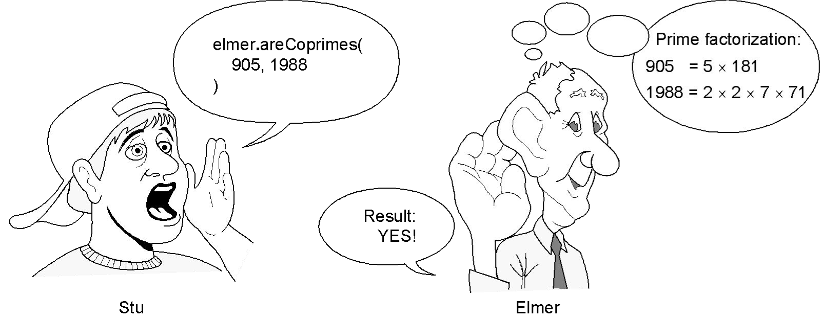
Object Calling and Answering
Example:
Two integers are said to be coprime or relatively prime if they have no common factor other than 1 or, equivalently, if their greatest common divisor is 1.
Elmer is an object with the method areCoprimes
Stu calls Elmer’s method with input 905 and 1988
Elmer runs the method and returns “YES”
Key Considerations:
Stu must adhere to rules about calling Elmer’s method
Number of inputs, data types, etc
Rule definition exists on Elmer
Elmer might want to keep internals secret

Slide 4
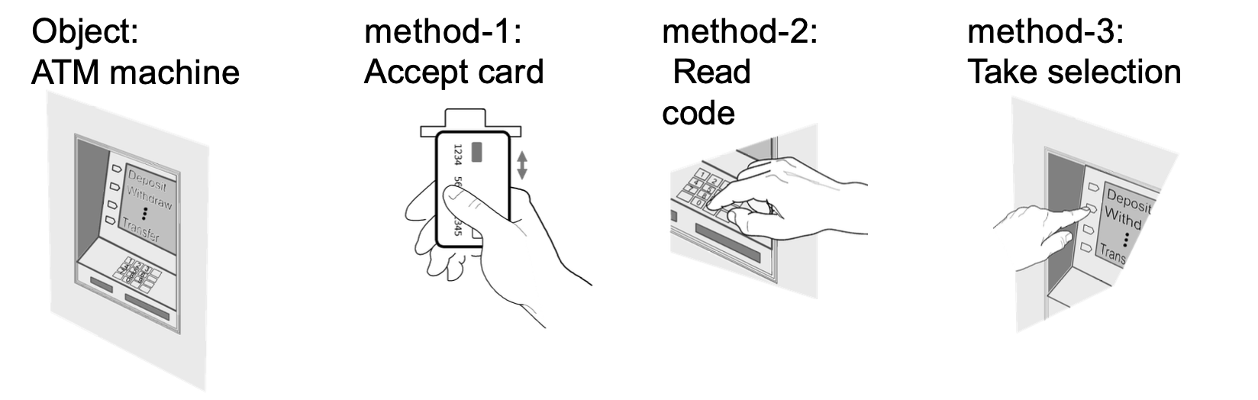
Object Calling and Answering
Important: Objects don’t accept arbitrary calls
Acceptable calls are defined by methods a.k.a. Operations, Procedures, Subroutines, Functions
Each method has its own signature (name, params, types etc)
Notes:
Each one of these methods has asignature .
We need a term to define what their grouping is. We call it an interface:

Slide 5
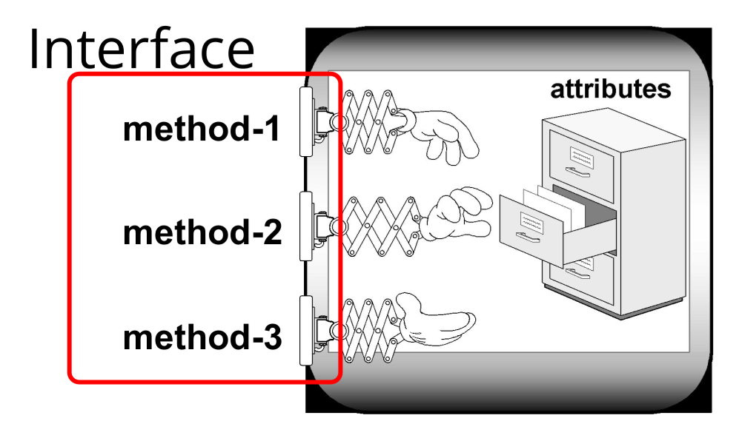
Object Interface
Every method has a signature
An object’s interface is the set of method signatures for that object
An object can hide its state (attributes), restricting access through an interface (Information Hiding)

Slide 6
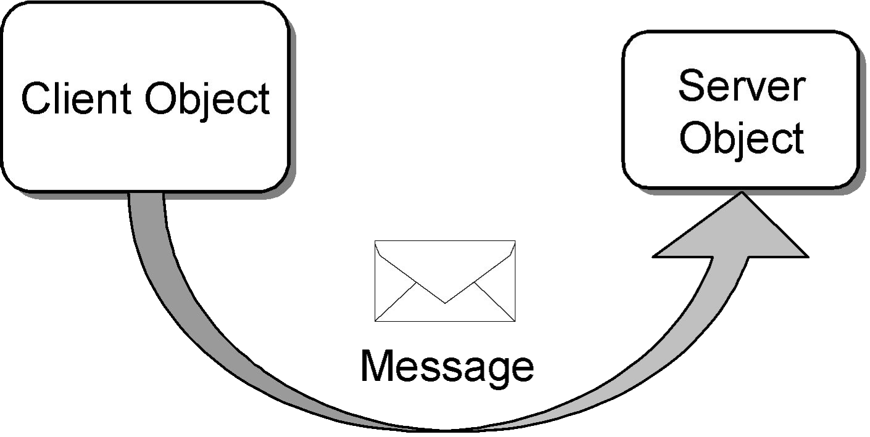
Client and Server Objects
Objects send messages by calling methods
The method call is the message
Object calling the method is the client object
Object receiving and executing the call is the server object
Notes:
Our software systems are often split into client and server components. If we understand objects to exists on both ends, we have to consider how they communicate ie) send messages).
In http world. The message we might send is “getCars” or getStudents. The client side object would call the server side one and the message is the http rest call.

Slide 7
Object Interfaces
An object’s interface is the set of method signatures
Methods define the “services” the server object will offer
An interface is a set of functional properties (services) that a software object provides or requires.
The methods (services) should be created and named based on the needs of client objects that will use the services
“On-demand” design - we “pull” interfaces and their implementations into existence from the needs of the client, rather than “pushing” out the features that we think a class should provide
Notes:
Which means that we only expose what the client objects will need. “getStudentMarks” as opposed to “LinkStudentAveragesToUserDetailsandReturn”

Slide 8
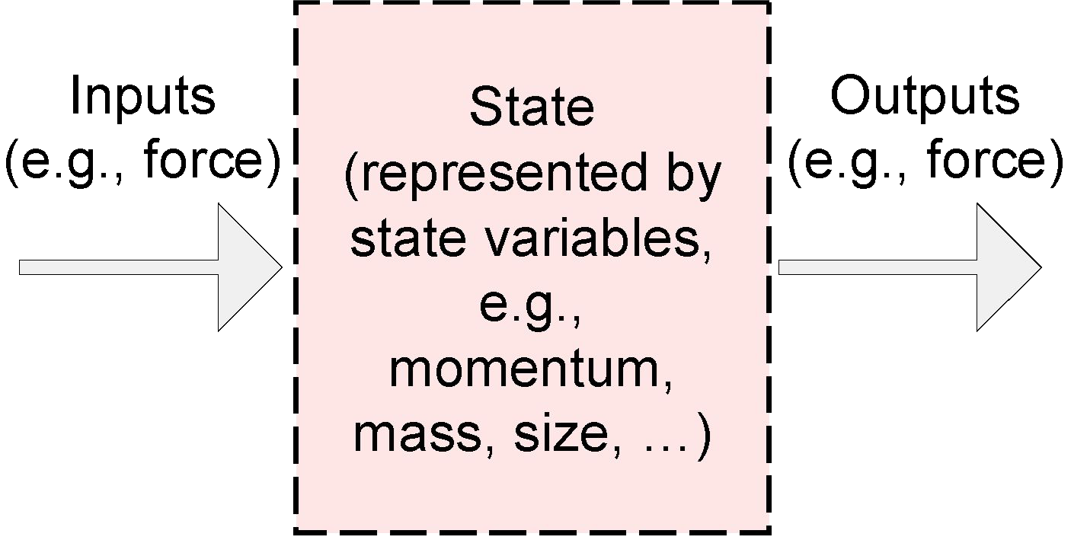
Modularity
Modular programming is a software design technique that emphasizes separating the functionality of a program into independent, interchangeable modules (packages).

Slide 9
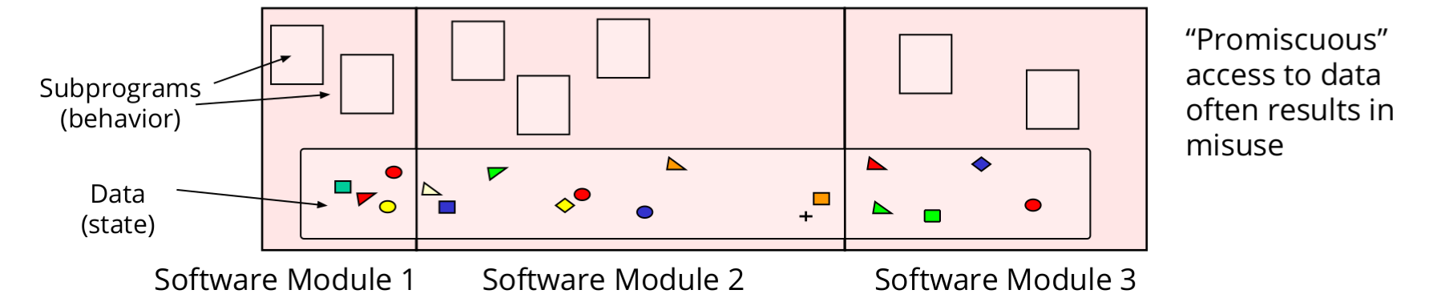
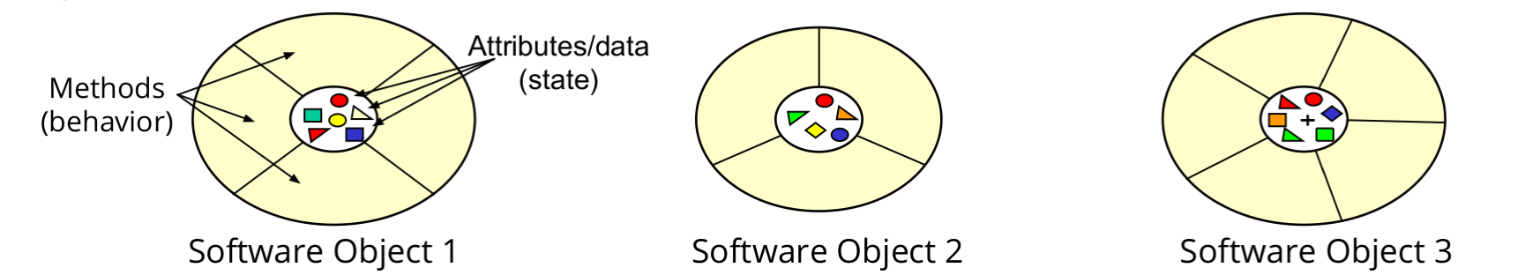
Modules vs Objects
Modules are loose groupings of subprograms and data
Objects encapsulate data

Slide 10
How do we represent & communicate these objects?
UML

Slide 11
UML
UML, or Unified Modelling Language, is a standardized visual language used in software engineering to represent different aspects of a system's structure and behaviour. It includes various diagram types such as class diagrams, use case diagrams, sequence diagrams, activity diagrams, and state machine diagrams, each serving specific modelling purposes.

Slide 12
Key components of UML include:
Class Diagrams: Represent the structure of a system by showing classes, their attributes, methods, and relationships.
Use Case Diagrams: Illustrate interactions between actors (users or external systems) and the system to achieve specific goals.
Sequence Diagrams: Depict interactions between objects in a scenario or use case over time.
Activity Diagrams: Model the flow of activities or actions within a system or use case.
State Machine Diagrams: Describe the states of an object or system and transitions between those states triggered by events.
Component Diagrams: Show the components of a system and their relationships.
Deployment Diagrams: Visualize the physical deployment of software components across hardware nodes.
Package Diagrams: Organize and structure the elements of a system into logical groupings.
Notes:
These components collectively provide a comprehensive way to model different aspects of software systems during the software development process.

Slide 13
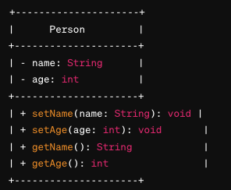
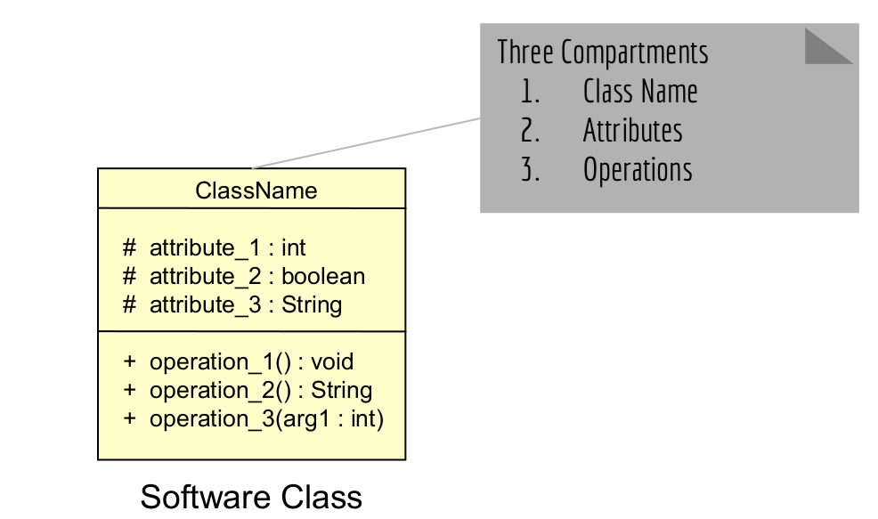
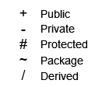
UML Notation for Classes
Notes:
But objects have reltions to each other and we need to show that too.

Slide 14
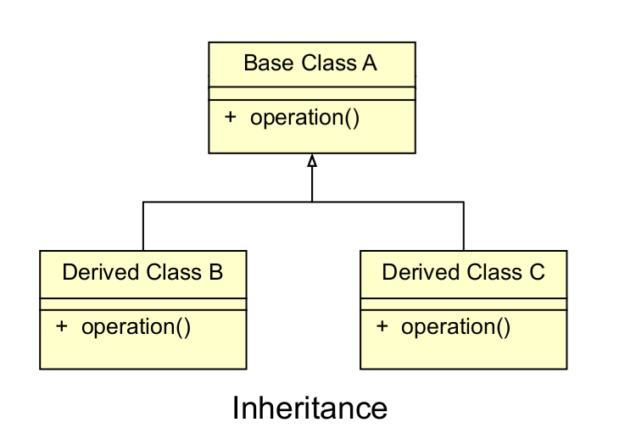
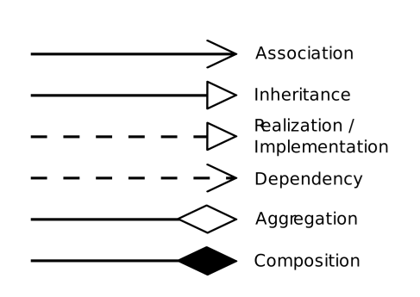
UML Notation for Classes
Notes:
More on these relationships:

Slide 15
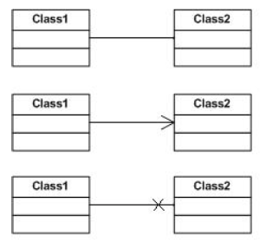
UML Object Relationships: Association
Association: one object accesses the other in some way (i.e. calling a method, accessing an attribute, etc.)
Eg: Owner feeds pet, dog barks at a cat.
Examples:
Top: bidirectional association
Middle: unidirectional association
e.g. Class1 accesses Class2
Bottom: prohibited association e.g. Class1 cannot access Class2

Slide 16
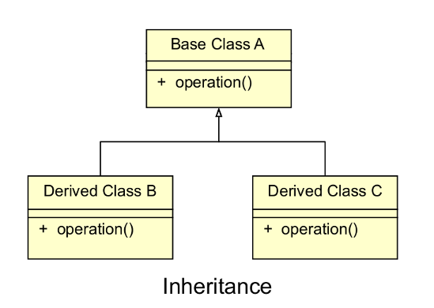
UML Object Relationships: Inheritance
Inheritance (aka generalisation): an object inherits the properties of another object through class extension
Eg: A cat is a type of pet, a dog is a top of pet
“is a” relationship

Slide 17
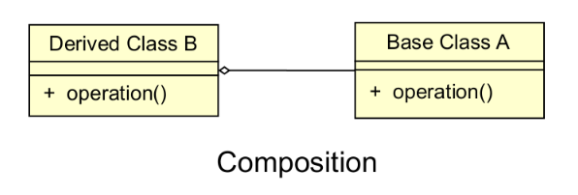
UML Object Relationships: Composition
Composition: an object references another object as an instance variable
e.g. a dog has a tail
“has a” relationship

Slide 18
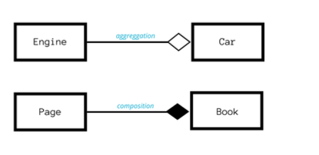
UML Object Relationships: aggregation
Composition is sometimes differentiated from aggregation
Aggregation implies the child class can exist without the parent
Composition implies the child class cannot exist without the parent
Some sources treat both as composition
Notes:
Eg: a a person and their bodyparts is composition because hands don’t just exist.
Car and parts is aggregation because it streeswes the pont that parts can exist with out ownership of car

Slide 19
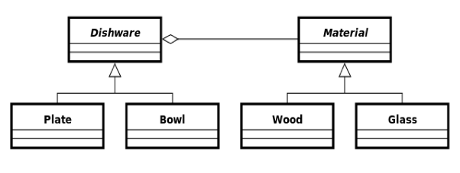
Object Relationships
Both inheritance and composition extend the base functionality provided by another object
Inheritance: Change in the “base” class propagates to the derived class and its client classes
BUT, any code change has a risk of unintentional introducing of bugs.
Composition: More adaptive to change, because change in the “base” class is easily “contained” and hidden from the clients of the front-end class

Slide 20
Polymorphism
Polymorphism, in object-oriented programming (OOP), refers to the ability of objects of different classes to be treated as objects of a common superclass. It allows methods to be invoked on different objects in a uniform manner, even though these objects may belong to different classes and exhibit different behaviours.
Polymorphism is the provision of a single interface to entities of different types. In essence, it is the ability to take on many forms.
Eg: Ducktyping

Slide 21
Two types of Polymorhism
Compile-time Polymorphism (Static Binding or Early Binding)
Decision on which method to call is made at compile time
Method & operator overloading
Runtime Polymorphism (Dynamic Binding or Late Binding):
- decision about which method to call is made at runtime based on the type of the object
- It is achieved through method overriding and interface implementation.
- involves redefining a method in a subclass that is already defined in its superclass.

Slide 22
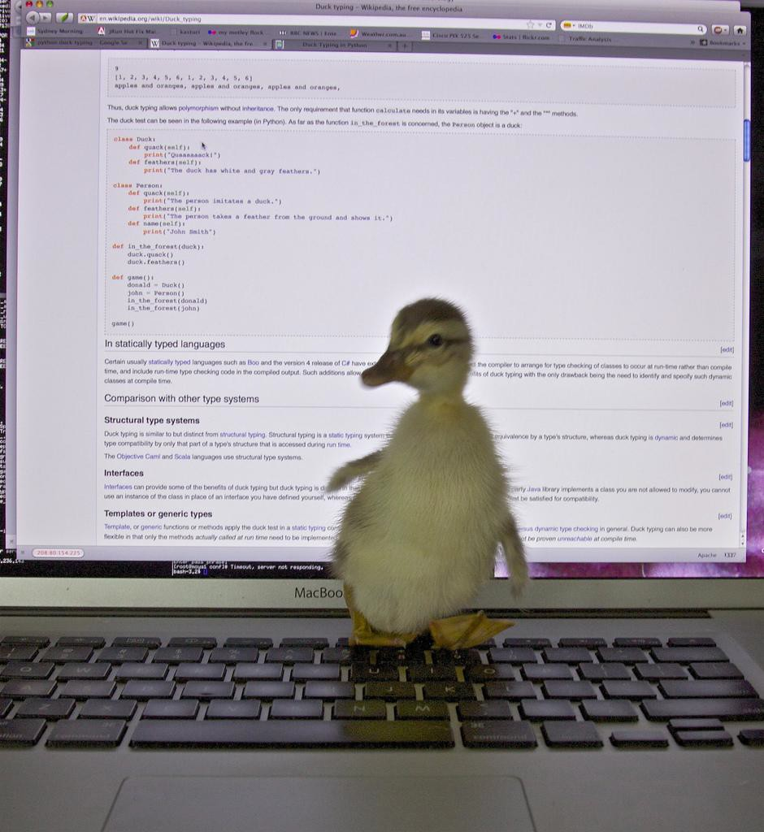
Duck Typing
Duck Typing – an object’s type/class is less important than the methods it defines
"If it walks like a duck and it quacks like a duck, then it must be a duck"
Don’t check types, check for methods/attributes instead

Slide 23
Duck typing
In duck typing, the focus is on the object's behaviour rather than its actual type or class. If an object supports the required methods or properties needed for a particular operation, it is considered to be of the expected type, even if it does not explicitly inherit from that type.
Eg: iterating over collections of all types.

Slide 24
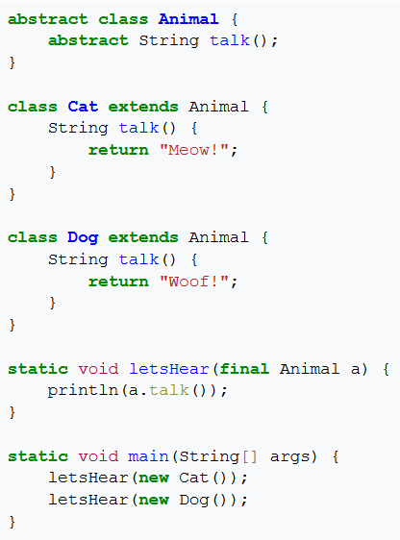
Polymorphism
Subtyping is a type of polymorphism where code written for a supertype will work on a subtype
Often achieved with inheritance

Slide 25
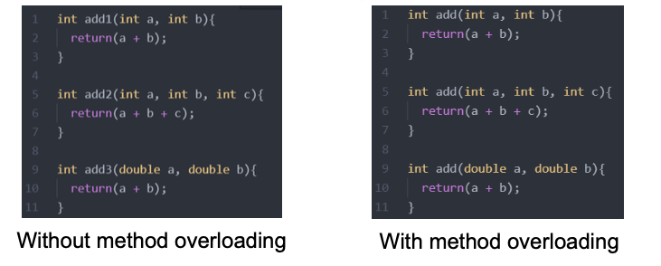
polymorphism
Ad-hoc polymorphism, also known as method / operator overloading, refers to a single name or symbol having multiple implementations depending on the arguments

Slide 26
Polymorphism
If the implementation under a polymorphism is selected at compile time, the polymorphism is static
If the implementation under a polymorphism is selected at run time, the polymorphism is dynamic
Also called static dispatch and dynamic dispatch
Which type is used depends on the programming language

Slide 27
Why Polymorphism
Pros
Allows programmers to reuse code
Helps cut down on the size of code
Can improve the modularity of code
Cons
Can be very complex
Can make code harder to read (not sure which implementation will be called)
Dynamic dispatch can be slower

Slide 28
Why Object-Oriented Design?
Modularity and reusability make development:
Easier
Faster
More productive
Cheaper
Modularity makes systems easier to maintain
However, can be complicated to design and explain

Slide 29
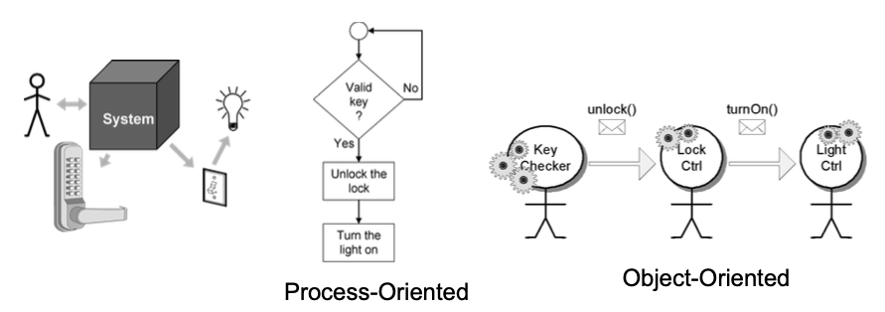
Object-Oriented vs Process-Oriented
Example: secure door and automatic lights

Slide 30
Object-Oriented vs Process-Oriented
Process-Oriented is more intuitive because it is person-centric (x happens then y)
Object-oriented may be more confusing because of labour-division
Thinking how to break-up the problem into tasks, assign responsibilities, and coordinate the work It’s a management problem...
Object-Oriented is organisation-centric, designed to scale to large problems
- But it’s hard to design an organisation well...

Slide 31
How do we design OO systems well?
That’s basically what the whole course is about...
Key methodological factors:
Agility (like the scrum process)
Traceability
Testability
Measurability
Security

Slide 32
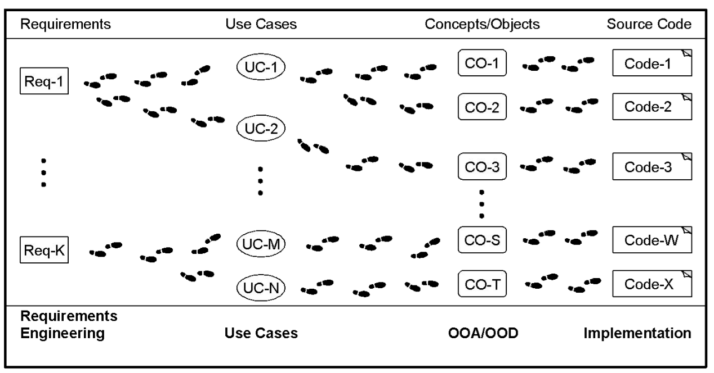
Traceability
It should be possible to trace the evolution of a software system, step-by- step, from individual requirements to blocks of code
You should always be able to answer “why is this here?”
Good traceability ensures you are
spending your time and resources on the right things

Slide 33
Testability
Test-Driven Development (TDD): Software requirements should be converted to test cases before software is fully developed
Every step in the development process must start with a plan of how to verify that the result meets a goal
The developer should not create a software artifact (a system requirement, a UML diagram, or source code) unless they know how it will be tested
Facilitated by continuous integration tools

Slide 34
Measurability
Measure the quality of the software
e.g. usage statistics, bug reports, performance, optimisation
Measure the productivity of development e.g. Scrum points per unit time, burndown charts, etc.
However, often better just to let everybody do their job

Slide 35
Security
Often need to consider security of a system when designing it
Security issues can arise due to:
Poorly designed code, which can be exploited
Interconnectivity, meaning one compromised system can be used to compromise those connected to it
Security needs may conflict with other requirements e.g. ease of use

Slide 36
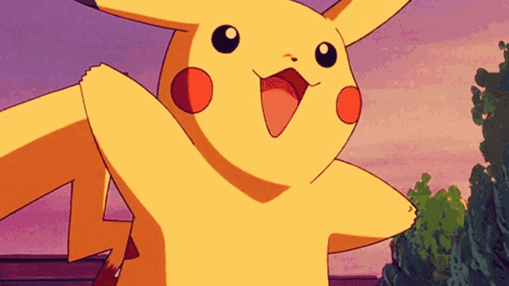
Bye bye

